Slide 1
Employee Attrition Analysis at Company A
Max Moro and Shane Weinstock

Slide 2
Response and Scenario
Company A has experienced and recorded attrition information in regard to its workforce. The data that is available to us covers the period of 2010 through 2019.
We have focused on the attrition rate for Company A and correlated variables to help us accurately forecast future attrition rates.
Some of the variables of interest are:
Age of employee
Tenure at Company A
Satisfaction
Annual performance ratings
Salary
Monetary recognitions (bonuses)

Slide 3
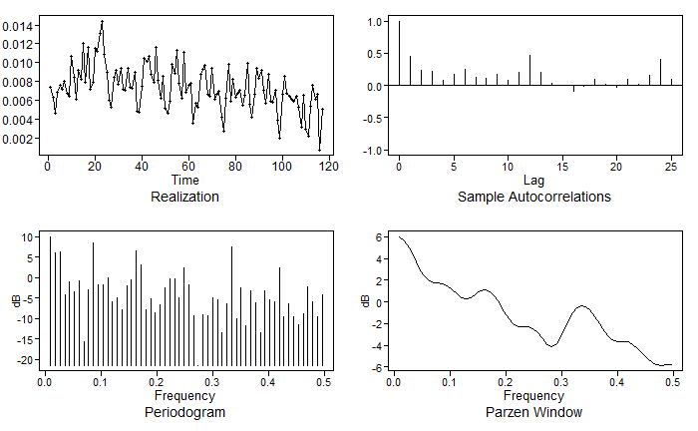
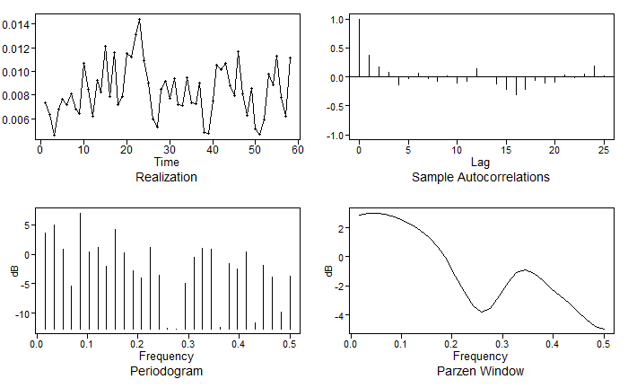
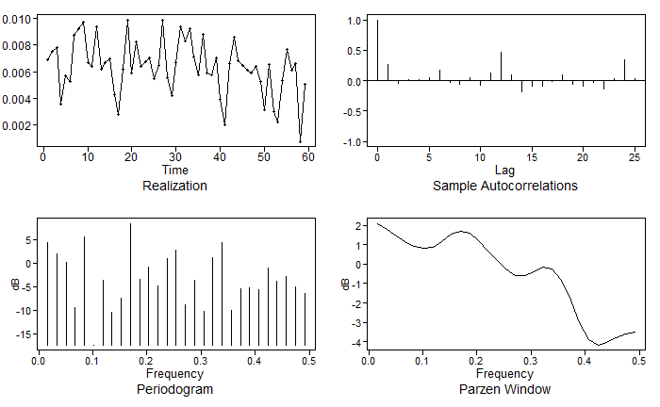

Model 1 Identification
Realization of Full Dataset
Realization of First Half
Realization of Second Half
Condition 1 and 2 for stationarity were not met as our mean and variance depend on time.
Condition 3 is not met as our ACF depends on time.
The ACFs show quasi-cyclic behavior with some seasonality present.
Our Parzen-Window show peaks at frequencies of .17 and .34, approximately 3 and 6 months
Factor tables indicate that factors of s = 3 are present.
We also observed that the following factors were present:
They appeared in our data more specifically as:
Notes:
Mention conditions and note frequencies for transformation. The data is not stationary.

Slide 4
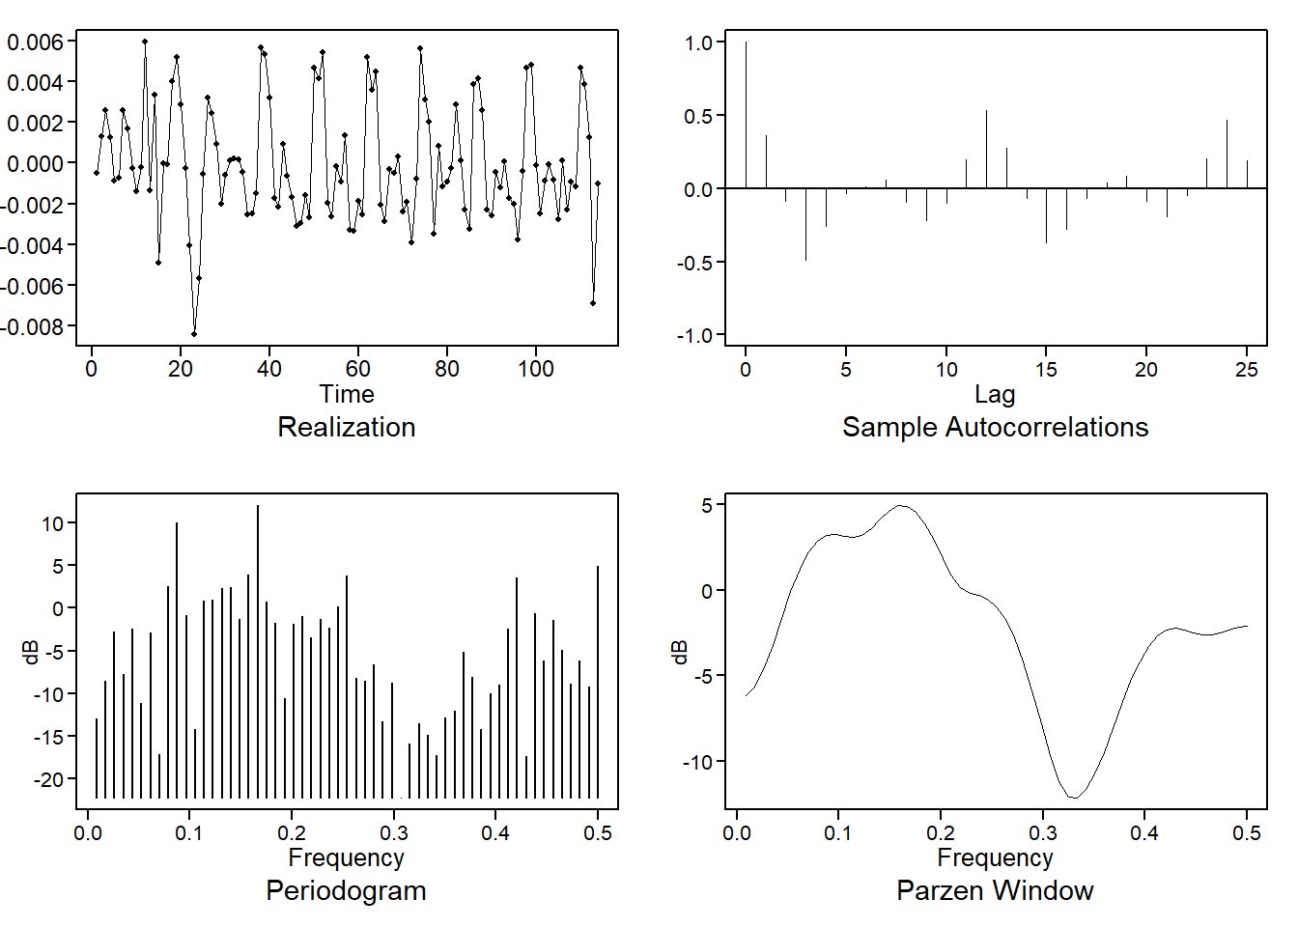
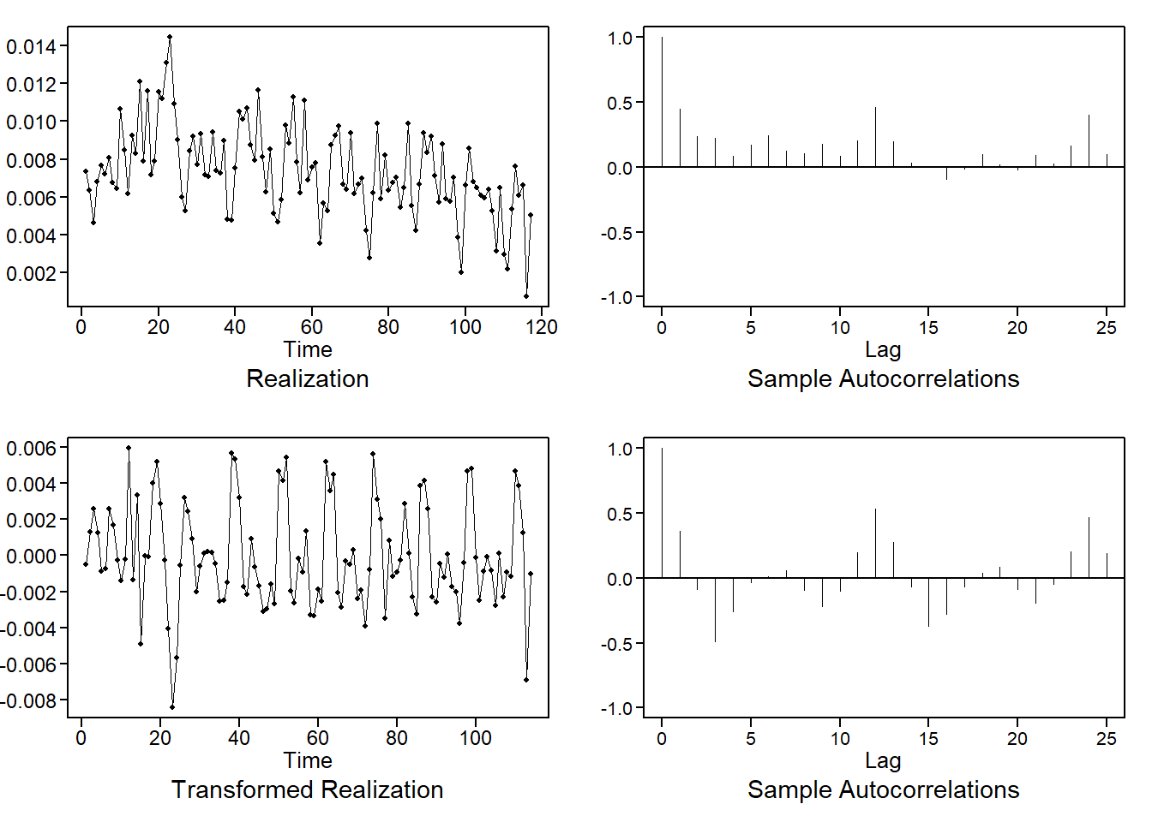
Model 1 Identification - Cont.
Before continuing, we removed the s = 3 seasonality from the data.
Above are the new plots with the adjusted frequency after the transformation.

Slide 5
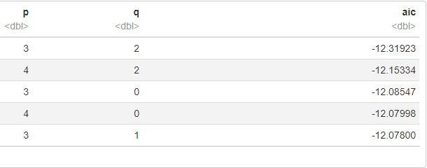
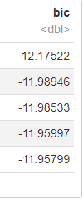
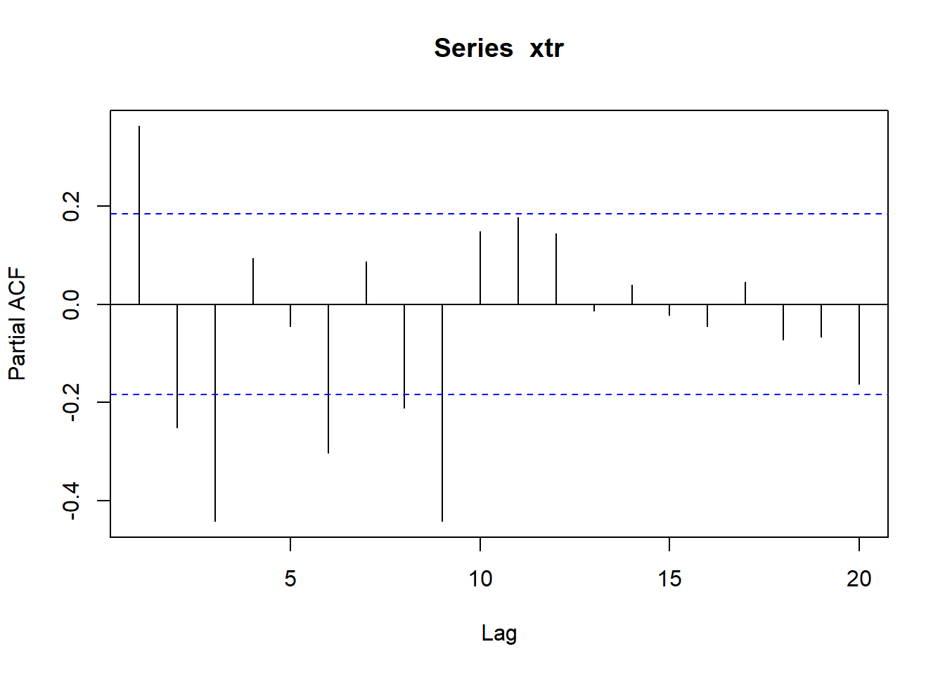
Model 1 Fit
Between our plots and the PACF, we notice that there are erratic patterns up to AR(9), likely indicating that this is not a pure AR model.
Sample autocorrelations continue to portray a sinusoidal pattern past .5, which notions us against a pure MA model.
AIC5 returns an ARMA(3,2) and an ARMA(4,2). And thus, with our evidence, that is what we’ve proceeded to our final model with.
Notes:
Main Takeaway: AIC5 returned the ARMA(3,2) and ARMA(4,2) and with these we proceeded to our final models.

Slide 6

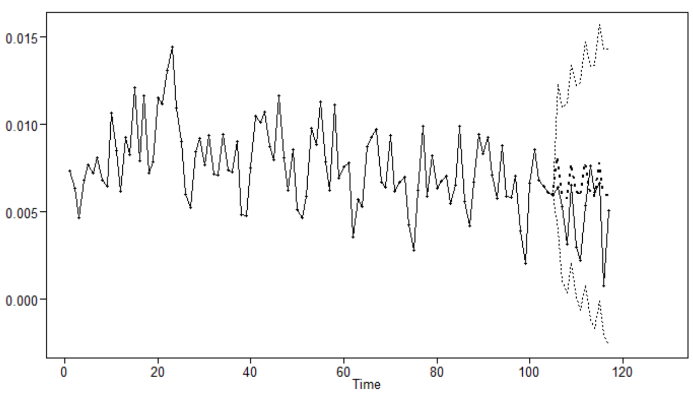
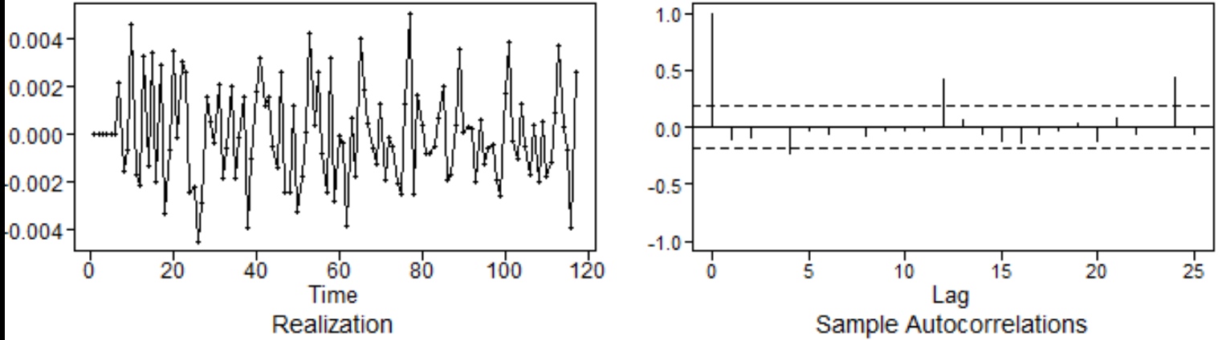
Model 1
ARMA(3,2) with s = 3
The model above is depicted in the graph to the left.
The graph left shows predictions for the test dataset of 12 months based off the model above.
The ASE of the model is 0.00000623
Residuals: We can visually see we still have some correlation between residuals; hence the model can be improved. This hint has been also confirmed by the Ljung-Box statistical test

Slide 7
Model 2 VAR – External Predictors
The VAR model gives us the advantage of using external predictors to explain the behavior of the target variable (attritionRate).
We selected the following external predictors
Predictors | Meaning
ageMeanYears | average age of the active workers
tenureMeanYrs | average tenure of the active workers
workersPerSupervisor | average number of workers reporting to each supervisor
lowPerfRate | ratio of low performers for the entire organization
highPerfRate | ratio of high performers for the entire organization
Notes:
The most significant correlations with the Attrition Rate are Mean Age with lags of 5 and -5, tenure with a significant correlation at lag 6, and lastly workers per supervisor with a correlation at lag 5. Low Performers Ratio is correlated with a lag of -2.

Slide 8
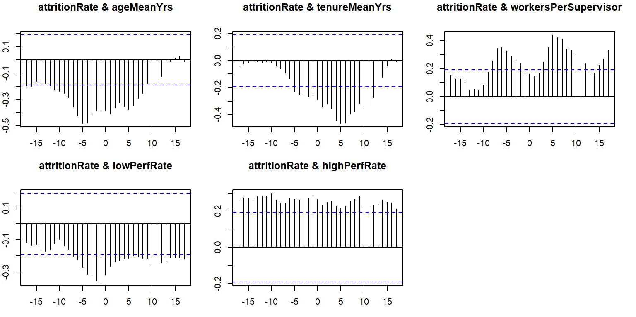
Model 2 VAR – Lags
The VAR model is flexible enough to automatically detect and use correlation between variables and across different points in time (lags)
Cross Correlation of Included Variables
From the above correlation plots, we can deduct the model may use lags up to 6.
Notes:
The most significant correlations with the Attrition Rate are Mean Age with lags of 5 and -5, tenure with a significant correlation at lag 6, and lastly workers per supervisor with a correlation at lag 5. Low Performers Ratio is correlated with a lag of -2.

Slide 9
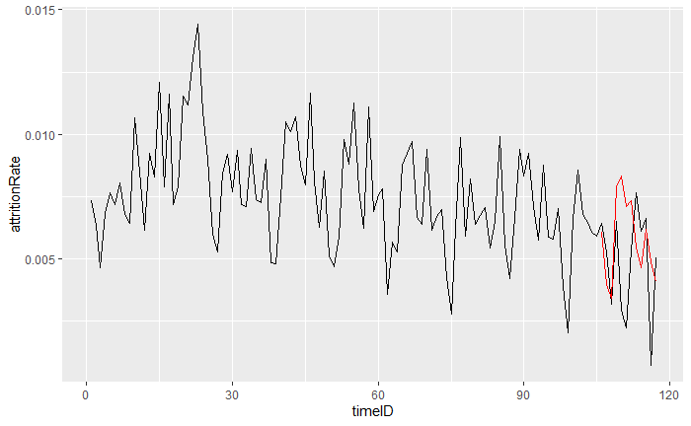
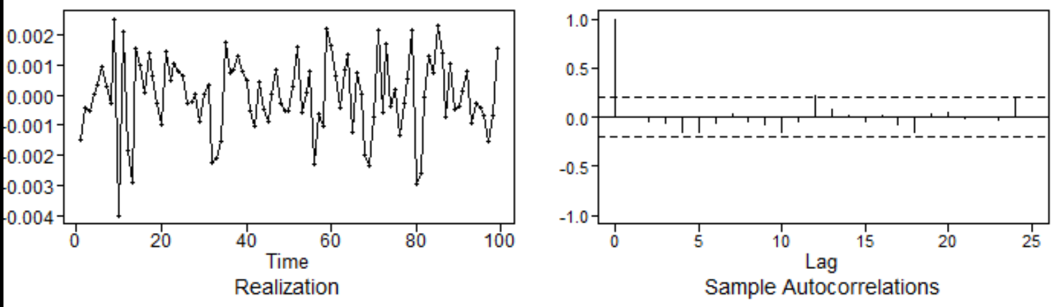
Model 2 VAR - Fitting
We obtained a VAR model that uses a lag 6, with a total order of 60 predictors.
This charts compare the model’s prediction (red) vs the Test data-set (black).
We can see the complexity of the model produces a better fit than ARMA
The ASE of the model is 0.00000711
Residuals: We can visually see 1 or 2 correlation between residuals, over a total of 24 lags.
We are confident the model is able to explain most of the behavior of the target variable.

Slide 10
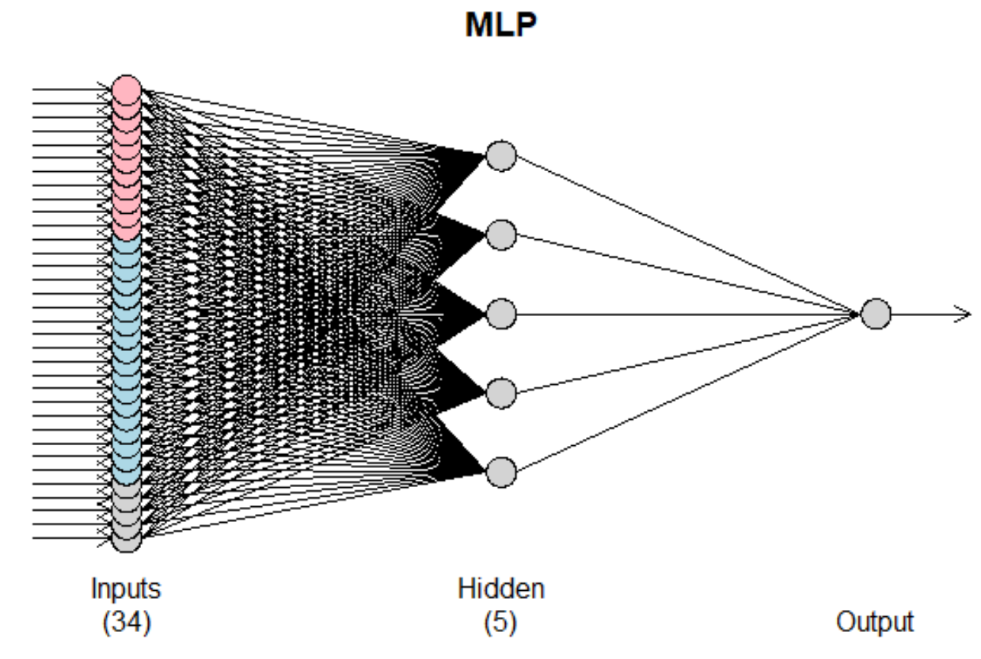
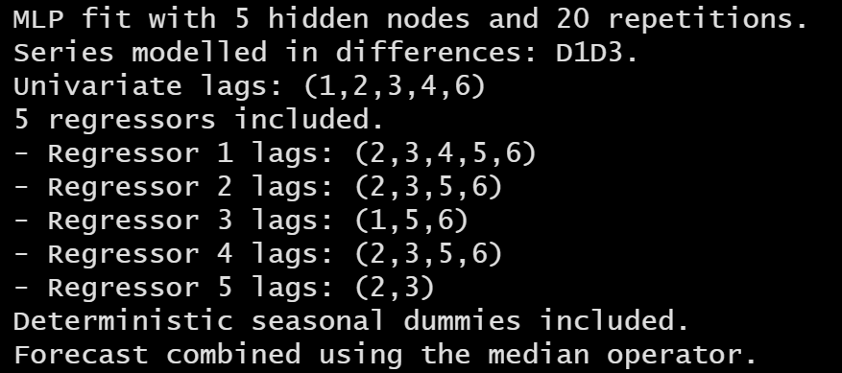
Model 3 Neural Network - Fitting
The Neural Network gives the power of modeling more complex relationships between variables.
We are using the same type of external variables used by the VAR model. Based on experience from the ARMA and VAR models, we used a seasonality of 3 and analyzed lags from 1 to 6.
The model used 5 regressors, 5 hidden nodes, seasonal components, and a different set of lags per each regressor.
We can see this model is more complex than the VAR one.
Notes:
What else did we use here to fit it?
Talk about CV and number of reps?

Slide 11
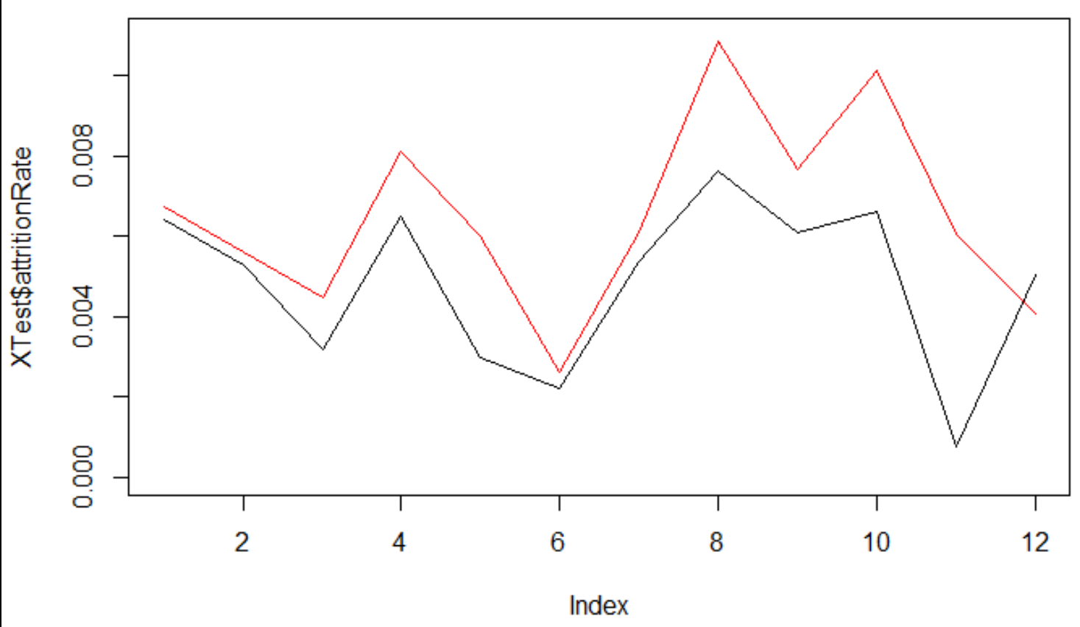
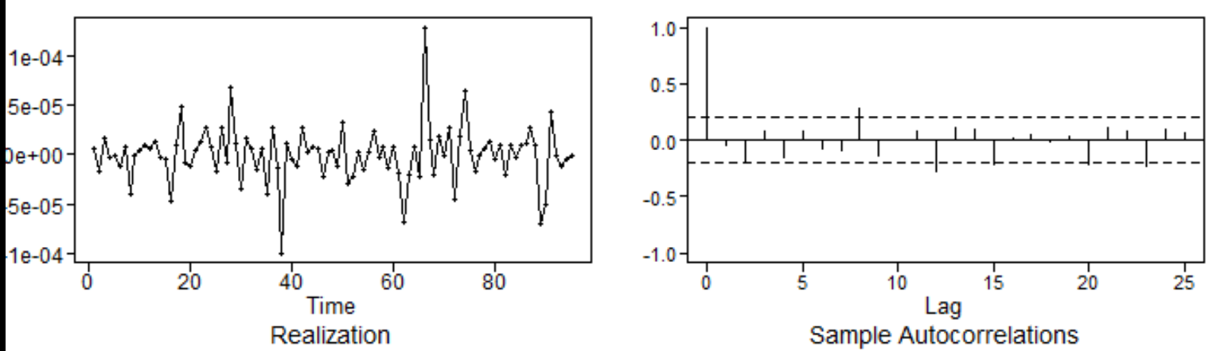
Model 3 Neural Network - Performance
This charts compare the model’s prediction (red) and the Test data-set (black)..
The flexibility of the Neural Network produced a closer fit to the data.
The ASE of the model is 0.00000573
Residuals: We can visually see we still have some correlation between residuals.
The model is not able to explain the entire behavior of the target variable.
Notes:
Notation on NN? Extended forecast for NN?

Slide 12
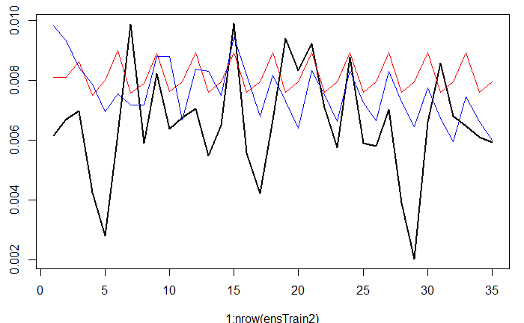
Model 4 Ensemble - Approach
The Neural Network model has a great ASE performance, but it is not feasible for the business as we need to know the future values of the external variables to calculate the attrition rate prediction.
The best models for the business are VAR and ARMA(3,2).
We used a Neural Network algorithm to combine and improve the predictions of VAR and ARMA models.
In this plot, we can observe two things:
The VAR line (colored blue) is very similar to the pattern of our prediction
The ARMA model (colored red) depicts our mean more accurately.
Our goal is to combine the aspects of both of these to create the most predictive model.
Notes:
Other aspects to include on ensemble? What did we cover in class.

Slide 13
Model 4 Ensemble – Model Fit Strategy
We used the first 2/3 of the train dataset to fit the VAR and ARMA models, then the last 1/3 of the train dataset to fit the Neural Network Model based on the output of the first two models. We will then use the test dataset (12 months) to measure the performance of the ensemble model. This approach is called ‘Blending’.
Training VAR and ARMA
Training Neural Network
Testing Ensemble
Train Dataset
Test Dataset
https://www.analyticsvidhya.com/blog/2018/06/comprehensive-guide-for-ensemble-models/
Notes:
Need to explain more on the ensemble’s creation. What aspects we were trying to capture.

Slide 14
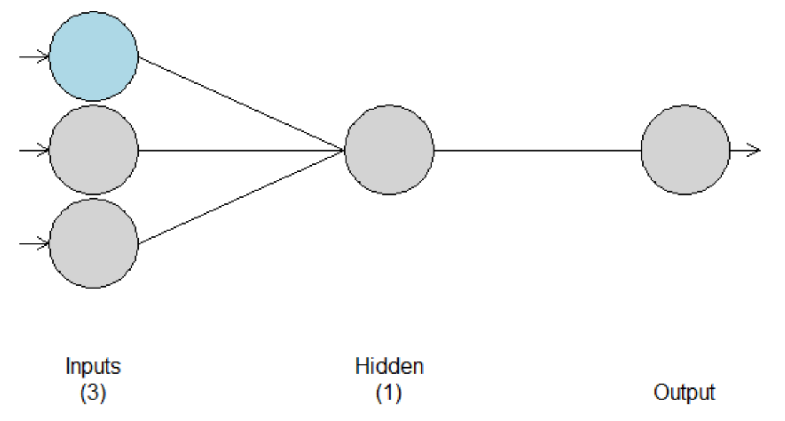
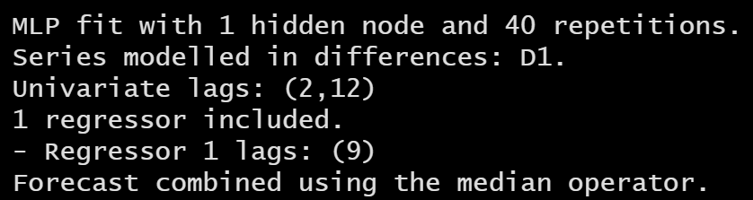
Model 4 Ensemble – Model Fit
We can see that the Neural Network model combines the output of the VAR and ARMA models in a network composed by 2 inputs, 1 regressor of lag 9, and 1 hidden layer
The neural network model has been able to detect lags between the base models and the target variable.
Notes:
Need to explain more on the ensemble’s creation. What aspects we were trying to capture.

Slide 15
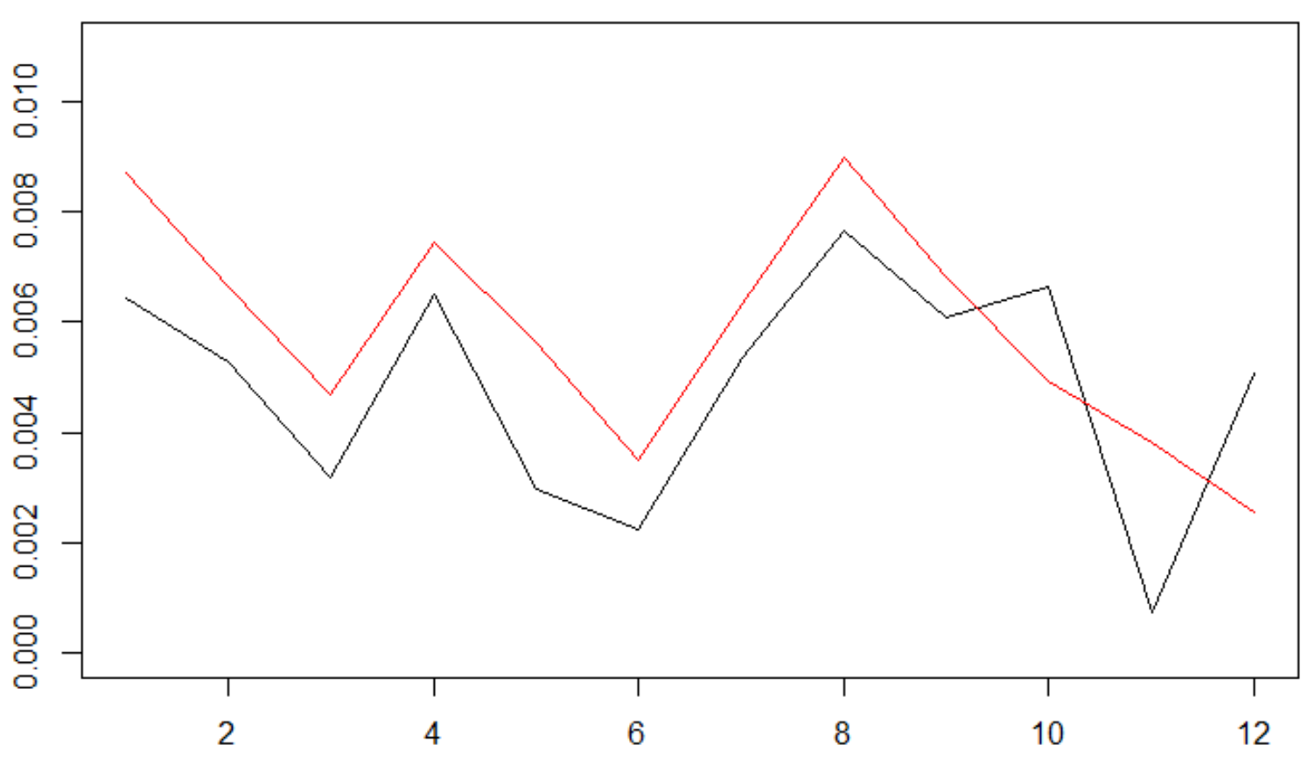
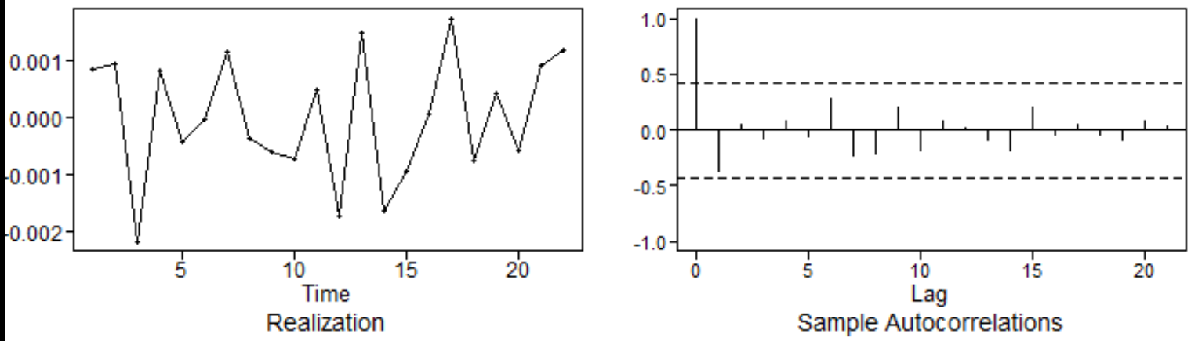
Model 4 Ensemble – Model Performance
This charts compare the model’s prediction (red) vs the test data-set (black).
We can visually see we have much better fit than the individual VAR and ARMA models
The ASE of the model is ASE 0.00000341
Residuals: We can visually see we have no significant correlations between residuals.
The model is able to explain the entire behavior of the target variable.
Notes:
Need to explain more on the ensemble’s creation. What aspects we were trying to capture.

Slide 16
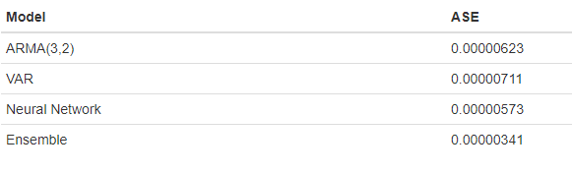
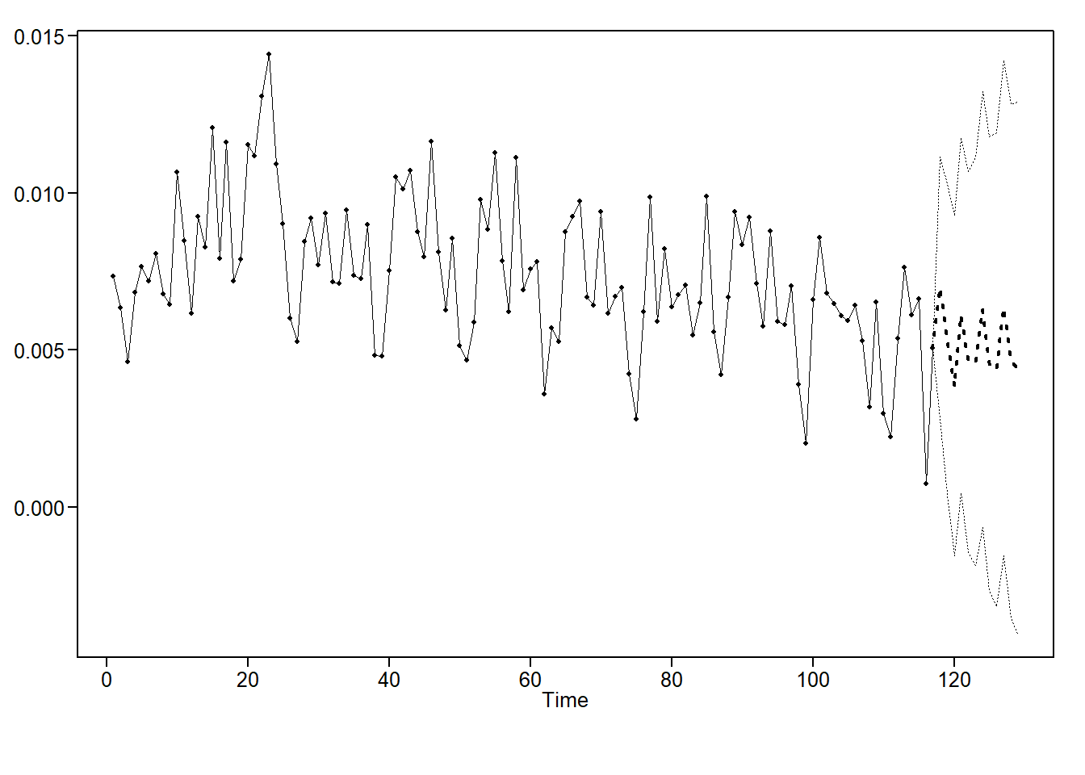
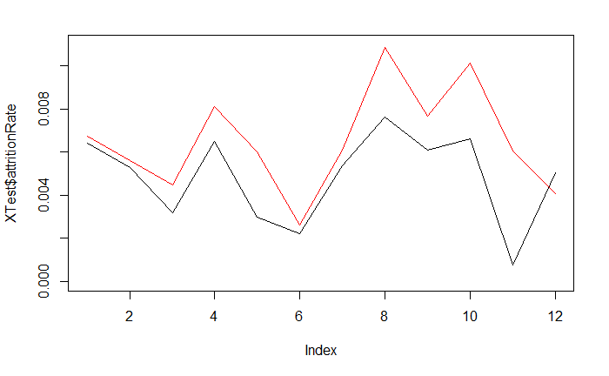

Model Comparison
It’s important to note that our ASEs are all quite close in relation to our studies.
Model 1 – ARMA(3,2) produced very safe results that hovered around the mean.
Model 2 – VAR – was able to capture our trend well.
Model 3 – Neural Network – enabled us to begin to apply the trend with the adjusted mean.
Model 4 – Ensemble - allowed us to finally include all of these aspects so that our forecast includes the trend, mean, and pattern of our data moving forward in the most accurate prediction.
ARMA(3,2)
VAR
Neural Network
Ensembe
Notes:
Models are
Model 1: Top Left – ARMA
Model 2: Top Right – VAR
Model 3: Bottom Left - NN
Model 4: Bottom Right – Ensemble

Slide 17
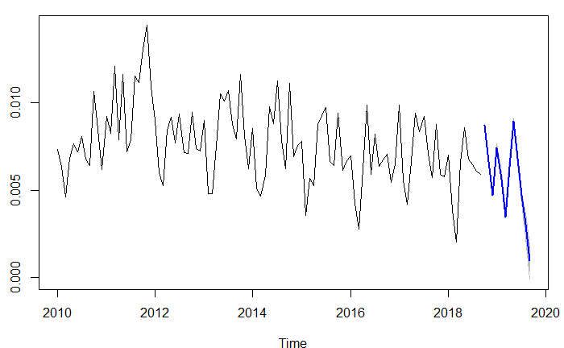
Forecast
The market the company operates in is very dynamic and competitive, so is not realistic to create a forecast more than 1 year ahead.
Based on the performance and behavior of the models, we selected the Ensemble Model as the ideal for producing forecast for the next 12 months.
The Blue Line shows the forecast of the Attrition Rate for the next 12 months. We can see it shows the historical pattern and behavior of the data.
We see an overall reduction of attrition rate, with some peaks and valleys repeating at seasonal intervals
The light blue area is showing the range of predictions the neural model is able to produce (based on 40 repetitions of the model)
Notes:
Need to explain more on the ensemble’s creation. What aspects we were trying to capture.

Slide 18
Conclusion
The models show critical aspects of the attrition rate trend for the company:
It has a seasonal behavior every 3 and 12 months
It is correlated to other factors, like tenure, age, number of direct reporting, and performance of the workforce.
These are important factor the company can use to mitigate the risk of undesirable turnover, like:
Controlling the number of direct reporting.
Retention programs based on the age and tenure of the workers.
Anticipating the number of new hires needed to offset the future attrition rate.

